Slide 1
Distributed Transaction Management
Dr. Supriya Chakraborty

Slide 2
Recapitulate the Centralized System
Transaction
Schedule
ACID
Cost of Transaction – Disk Access Verses Transmission through Network

Slide 3
Log Based Transaction Scheme in Centralized System
What is Log?
Log is a file that contains all the details of the Transaction.
Log-ahead write strategy
Log is written before the database

Slide 4
Log File Contains
Begin Transaction Marker
User information
Date and Time
Attribute
Before Image
After Image
End Transaction Marker

Slide 5
Example of working Principal of Transaction through Log
T5
T4
T3
T2
T1

Slide 6
Prepare Redo and Undo List
Redo List: T1 and T4
Undo List : T2, T3 and T5
Principal : If there is a failure, the recovery system attempts to get back the database to its immediate before consistent state.

Slide 7
Distributed Transaction- Begin_Transaction and Agent
1. There exists a root agent which starts the whole transaction, so that when
the user requests the execution of an application, the root agent is started;
the site of the root agent is called the site of origin of the transaction.
2. The root agent has the responsibility of issuing the begin-transaction, commit,
and abort primitives.
3. Only the root agent can request the creation of a new agent.
Notes:
Distributed Transaction
A transaction is always part of an application. When a user types an application code, he or she requests the execution of an application, which does not have the properties of atomicity, durability, serializability, and isolation. At some time after its invocation by the user, the application issues a begin_ transaction primitive; from this moment, all actions which are performed by the application, until a commit or an abort primitive is issued, are to be considered part of the same transaction. In some systems, the beginning of a transaction is implicitly associated with the beginning of the application, and the commit primitive ends a transaction and automatically begins a new one, so that the explicit begin_ transaction primitive is not necessary. However, the model with explicit primitives which is assumed here is more general.
In order to perform functions at different sites, a distributed application has to execute several processes at these sites. We will call these processes the agents of the application. An agent is therefore a local process which performs some actions on behalf of an application. Note that in the definition of agent we are not interested in knowing whether the agent executes a program written by the application programmer or a primitive function of the system; we have discussed that the programmer
can request the execution of a remote primitive or write an auxiliary program, install it at a remote site, and then invoke its execution. We have also discussed the difference between these two approaches from the viewpoint of the application programmer; however, if we consider the execution of the application, there will be
some code which is executed at the remote site in order to perform the required function, and it makes little difference for the purpose of this chapter to know how this code is produced. In both cases this code constitutes an agent of the distributed application.
In order to cooperate in the execution of the global operation required by the application, the agents have to communicate. As they are resident at different sites, the communication between agents is performed through messages. There are different ways in which the agents can be organized to build a structure of cooperating processes. These alternatives will be discussed in a later section. For the purpose of the discussion of atomicity we will assume that:
1. There exists a root agent which starts the whole transaction, so that when the user requests the execution of an application, the root agent is started; the site of the root agent is called the site of origin of the transaction.
2. The root agent has the responsibility of issuing the begin-transaction, commit, and abort primitives.
3. Only the root agent can request the creation of a new agent.

Slide 8
Fund Transfer in Global Level
FUND_TRANSFER:
Read(terminal, SAMOUNT, $FROM_ACC, $TO_ACC);
Begin- transaction;
Select AMOUNT into $FROM_AMOUNT from ACCOUNT where ACCOUNT- NUMBER=$FROM_ACC;
if $FROM_AMOUNT - SAMOUNT < then
abort
else begin
Update ACCOUNT set AMOUNT=AMOUNT – SAMOUNT where ACCOUNT- NUMBER=$FROM_ACC;
Update ACCOUNT set AMOUNT=AMOUNT + SAMOUNT where ACCOUNT-NUMBER=$TO-ACC;
Commit
end

Slide 9
Fund_transfer in two Agents
ROOT-AGENT:
Read(terminal,$AMOUNT, $FROM_ACC, STO-ACC);
Begin- transaction;
Select AMOUNT into SFROM-SAMOUNT
from ACCOUNT
where ACCOUNT-NUMBER=$FROM_ACCOUNT;
If SFROM-AMOUNT - SAMOUNT < then abort
else begin
Update ACCOUNT
set AMOUNT=AMOUNT - SAMOUNT
where ACCOUNT- NUMBER=$FROM_ACC;
Create AGENT₁;
Send to AGENT₁ (SAMOUNT, STO-ACC);
Commit
end
AGENT₁:
Receive from ROOT-AGENT (SAMOUNT, STO-ACC);
Update ACCOUNT
set AMOUNT=AMOUNT + SAMOUNT
where ACCOUNT-NUMBER=$TO_ACC;

Slide 10
Distributed Transaction Property
ASID
Atomicity
Serializability
Isolation
Durability

Slide 11
A Reference Model of Distributed Transaction
Interface 1 Local_begin, Local_Commit, Local_Abort, Local_Create
Interface 2 Begin_Transaction, Commit, Abort, Create
Interface 1': Local_lock_shared, Local_lock_exclusive, Local_unlock
Interface 2': Lock_shared, Lock_exclusive, Unlock

Slide 12

Recovery and Failure of Distributed Transaction
Distributed Log is Used
To recover from failure
Two-phase Commit
Protocol is used.

Slide 13
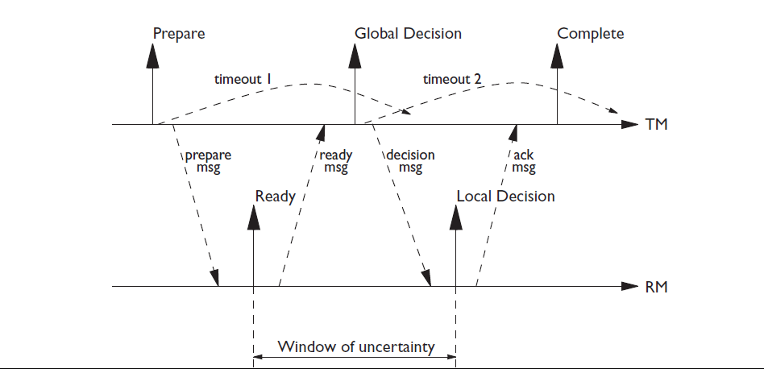
Distributed Transaction – 2PC
Notes:
2PC
Transaction Manager (TM) – The coordinator that controls the transaction.
Resource Manager (RM) – The sub-transaction where the data are going to be updated..
The two-phase commit protocol takes place by means of a rapid exchange
of messages between tm and rm. To make the protocol failure resistant, rm
and tm write some new records in their logs.
New log records are written during the two-phase commit protocol by
extending the log records shown in Section 9.4.2. Both tm and rm are
provided with their own logs. The tm writes additional log records.
• The prepare record contains the identity of all the rm processes (that is,
their identifiers of nodes and processes). Continuing with the marriage
analogy, this record corresponds to the announcements that are written
before the marriage.
• The global commit or global abort record describes the global decision.
Anticipating the protocol, we note that the time at which the tm writes
in its log the global commit or global abort record, it reaches the final
decision. A global commit decision consists of bringing the entire
transaction to a successful (that is, atomic and durable) termination on all
the nodes on which it works. A global abort decision consists of leaving
the initial database state unaltered on all the nodes at which the
transaction operates.
• The complete record is written at the end of the two-phase commit
protocol.
The rm process represents a sub-transaction. As in the centralized
context, each rm writes a begin record, followed by various records of
insert, delete, and update that represent the operations carried out by subtransactions.
As regards the two-phase commit protocol, there is a single new
record on the rm.
The ready record indicates the irrevocable availability to participate in the
two-phase commit protocol, thereby contributing to a decision to
commit. The identifier (process identifier and node identifier) of the tm is
also written on this record.
Note that the participant, once the ready record is written, loses all
independence of decision making. The final result of the transaction will be
decided by the tm. Furthermore, a participant can write the ready record
only when it is in a ‘recoverable state’. This means that it must use
appropriate locks to block all the resources to which it has access and it must
follow the wal and commit-precedence rules, as defined in Section 9.4.3, in
the management of its log.
In the absence of failure, the two-phase commit protocol consists of a rapid
sequence of writes on the log and of exchange of messages between the tm
and the rms. In communication with the rms, the tm can use broadcast
mechanisms that transmit the same message to many nodes. It must then be
able to collect responses arriving from various nodes. Otherwise, the tm uses
a serial communication with each of the rms.
The first phase of the protocol is as follows.
1. The tm writes the prepare record in its log and sends a prepare message
to inform all the rms of the start of the protocol. A timeout is then set by
the tm indicating the maximum time allocated to the completion of the
first phase. The timeout will expire in the case of an excessive delay in
the receipt of the reply message from some of the rms.
2. The rms that are in a recoverable state await for the prepare message. As
soon as the prepare message arrives, they write on their own logs the
ready record and transmit to the tm a ready message, which indicates the
positive choice of commit participation. If an rm is not in a recoverable
state, because a transaction failure has taken place, it sends a not-ready
message and ends the protocol. Any rm can at any time autonomously
abort a sub-transaction, by undoing the effects and ending the protocol
before it begins. As we shall see, the global effect of this situation on the
transaction is a global abort.
3. The tm collects the reply messages from the rms. If it receives a positive
message from all the rms, it writes a global commit record on its log. If,
however, one or more negative messages are received or the timeout
expires without the tm receiving all the messages, the tm writes a
global abort record on the log.
The second phase of the protocol is as follows.
1. The tm transmits its global decision to the rms. It then sets a second
timeout, which will be activated in the case of an excessive delay in the
receipt of responses from the rms.
2. The rms that are ready await the decision message. As soon as the
message arrives, they write the commit or abort record on their own logs.
Then they send an acknowledgement to the tm. At this point, the
implementation of the commit or abort proceeds on each server as
described in the preceding chapter. In particular, the pages modified by
the transaction are written to the database by the buffer manager.
3. The tm collects all the ack messages from the rms involved in the second
phase. If the timeout expires without the tm having received all the
acks, the tm sets another timeout and repeats the transmission to all the
rms from which it has not received an ack. This sequence is repeated
until all the rms respond by sending their acks. When all the acks have
arrived, the tm writes the complete record on its log.

Slide 14
2PC Algorithm
Coordinator: Write "prepare" record in the log;
Send PREPARE message and activate timeout
Participant: Wait for PREPARE message;
If the participant is willing to commit then
begin
Write subtransaction's records in the log;
Write "ready" record in the log;
Send READY answer message to coordinator
end
else begin
Write "abort" record in the log;
Send ABORT answer message to coordinator
end

Slide 15
Coordinator:
Wait for ANSWER message (READY or ABORT) from all participants
or timeout;
If timeout expired or some answer message is ABORT then
begin
Write "global- abort" record in the log;
Send ABORT command message to all participants
end
else (* all answers arrived and were READY *)
begin
Write "global- commit" record in the log;
Send COMMIT command message to all participants
end
Participant: Wait for command message;
Write "abort" or "commit" record in the log;
Send the ACK message to coordinator;
Execute command
Coordinator: Wait for ACK messages from all participants;
Write "complete" record in the log

Slide 16
Fund Transfer with 2PC

Slide 17
Demerit of 2PC
Failure of Transaction Manager in the First Phase leads to an uncertain state, thus 2 PC is also called Blocking Protocol.
What is the Solution?
The solution is Three-Phase Commit Protocol (3PC)

Slide 18
Different Failures: Distributed Transaction
Detail Analysis of Previous Slide
Site Failure
Message Failure
Network Failure or Partition
Notes:
1. Site failures
a. A participant fails before having written the ready record in the log.
In this case, the coordinator's timeout expires, and it takes the abort
decision. All operational participants abort their subtransactions. When
the failed participant recovers, the restart procedure simply aborts the
transaction, without having to collect information from other sites.
b. A participant fails after having written the ready record in the log.
In this case, the operational sites correctly terminate the transaction
(commit or abort). When the failed site recovers, the restart procedure
has to ask the coordinator or some other participant about the outcome
of the transaction, and then perform the appropriate action (commit or
abort). In this case, access to remote recovery information is required.
In the above discussion, we have considered writing the log and sending
the message as an atomic action. However, in a real system a failure can
occur after the log has been written and before the message is sent. In
this case the coordinator and all other operational participants would
behave as in the above point (la), while the failed participant would
perform restart as described here. The outcome is correct in this case
also. In the following we will normally assume that writing the log and
sending the message constitute an atomic action.
c. The coordinator fails after having written the prepare record in the
log, but before having written a global- commit or global- abort record
in the log. In this case all participants which have already answered
READY must wait for the recovery of the coordinator. The restart
procedure of the coordinator resumes the commitment protocol from the
beginning, reading the identity of participants from the prepare record
in the log, and sending again the PREPARE message to them. Each
ready participant must recognize that the new PREPARE message is a
repetition of the previous one.
d. The coordinator fails after having written a global-commit or
global- abort record in the log, but before having written the complete
record in the log. In this case, the coordinator at restart must send to all
participants the decision again; all participants which have not received
the command have to wait until the coordinator recovers. As before,
participants should not be affected by receiving the command message
twice.
e. The coordinator fails after having written the complete record in the
log. In this case, the transaction was already concluded, and no action
is required at restart.
2. Lost messages
a. An answer message (READY or ABORT) from a participant is lost. In
this case the coordinator's timeout expires, and the whole transaction is
aborted. Note that this failure is observed only by the coordinator, and
from the coordinator's viewpoint it is exactly like a participant's failure.
However, from the participant's viewpoint the situation is different; the
participant does not consider itself failed and does not execute a restart
procedure.
b. A PREPARE message is lost. In this case the participant remains in
wait. The global result is the same as in the previous case, because the
coordinator does not receive an answer.
c. A command message (COMMIT or ABORT) is lost. With the protocol
of Figure 7.5, the destination participant remains uncertain about the
decision. It is very simple to eliminate this problem by introducing
a timeout in the participant; if no command has been received after
the timeout interval from the answer, a request for a repetition of the
command is sent.
d. An ACK message is lost. With the protocol of Figure 7.5, the coordinator
remains uncertain about the fact that the participant has received the
command message. This problem can be eliminated by introducing a
timeout in the coordinator; if no ACK message is received after the
timeout interval from the transmission of the command, the coordinator
will send the command again. The best way of dealing with this case
at the participant's site is to send again the ACK message, even if the
subtransaction was completed in the meantime and is no longer active.
3. Network partitions
Let us suppose that a simple partition occurs, dividing the sites in two groups;
the group which contains the coordinator is called the coordinator-group;
the other the participant-group. From the viewpoint of the coordinator,
the partition is equivalent to a multiple failure of a set of participants, and
the situation is similar to that of points (la) and (lb) above: the coordinator
takes a decision and sends the command to all participants of the coordinatorgroup,
so that these sites can terminate correctly the transaction. From the
viewpoint of the members of the participant-group, the partition is equivalent
to a coordinator failure and the situation is similar to the above cases (lc)
and (Id).
Notice that the recovery procedure for a site which is involved in processing a
distributed transaction is more complex than that for a centralized database. In
centralized databases, just two cases are possible: transactions are either committed
or noncommitted, and the recovery mechanism performs the corresponding redo or
undo actions. In distributed databases, additional cases are possible:
1. A participant is ready (case lb). This situation is recognized by the recovery
mechanism because the ready record is in the log, but not a commit or abort
record.
2. A coordinator has initiated phase one (case lc). This situation is recognized
by the recovery mechanism because a prepare record is in the log, but not a
global-commit or global- abort record.
3. A coordinator has initiated phase two (case Id). The situation is recognized
by the recovery mechanism because the prepare and a global- commit or
global_abort record are in the log, but not a complete record.

Slide 19
3PC
The basic idea is to introduce a third phase in the standard protocol. Note that a participant is in pre-commit state only if all the other participants are ready, and so are in a recoverable state. The addition of a phase in the protocol allows the reaction to a failure of the tm by electing one of the participants as the substitute for the tm. This new coordinator can decide the result of the transaction by looking at its log.
3 PC is a non-blocking protocol

Slide 20
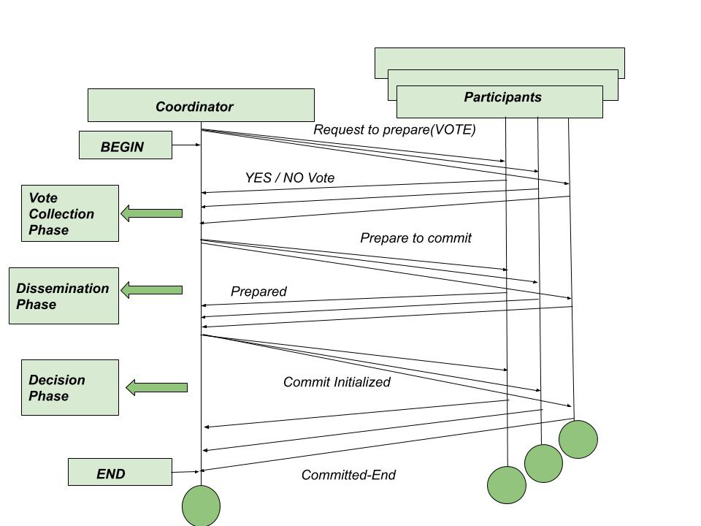
Three-Phase Commit Protocol

Slide 21
Atomicity for Distributed Transaction with Replicated Copies
A quorum is the minimum number of votes that a distributed transaction has to obtain in order to be allowed to perform an operation in a distributed system.
A quorum-based technique is implemented to enforce consistent operation in a distributed system.

Slide 22
Atomicity for Distributed Transaction with Replicated Copies
A quorum is the minimum number of votes that a distributed transaction has to obtain in order to be allowed to perform an operation in a distributed system.
A quorum-based technique is implemented to enforce consistent operation in a distributed system.

Slide 23
What is the purpose of Quorum Based Protocol ?
Quorum-based voting can be used as a replica control method, as well as a commit method to ensure transaction atomicity in the presence of network partitioning.

Slide 24
Situation to apply the Quorum
In a distributed database system, a transaction could execute its operations at multiple sites. Since atomicity requires every distributed transaction to be atomic, the transaction must have the same fate (commit or abort) at every site. In case of network partitioning, sites are partitioned and the partitions may not be able to communicate with each other. This is where a quorum-based technique comes in. The fundamental idea is that a transaction is executed if the majority of sites vote to execute it.

Slide 25
Quorum-based voting in commit protocols (1)
Every site in the system is assigned a vote Vi. Let us assume that
The total number of votes in the system is V and the ABORT and
COMMIT quorums are Va and Vc respectively.
Then the following rules must be obeyed in the implementation
Of the commit protocol.

Slide 26
Quorum-based voting in commit protocols (2)
Va + Vc > Vi, where 0 < Vc, Va <V
Before a transaction commits, it must obtain a commit quorum Vc. The total of at least one site that is prepared to commit and Zero at more sites waiting >= Vc
Before a transaction aborts, it must obtain an abort quorum Va. The total of zero or more sites that prepared to abort or any sites waiting >= Va.

Slide 27
Quorum-based voting in commit protocols (3)
The first rule ensures that a transaction cannot be committed and aborted at the same time.
The next two rules indicate the votes that a transaction has to obtain before it can terminate one way or the other.

Slide 28
Quorum-based voting for replica control (1)
In replicated databases, a data object has copies present at several sites. To ensure serializability, no two transactions should be allowed to read or write a data item concurrently. In case of replicated databases, a quorum-based replica control protocol can be used to ensure that no two copies of a data item are read or written by two transactions concurrently.

Slide 29
Quorum-based voting for replica control (2)
Each copy of a replicated data item is assigned a vote. Each operation then has to obtain a read quorum (V_{r}) or a write quorum (V_{w}) to read or write a data item, respectively. If a given data item has a total of V votes, the quorums have to obey the following rules:

Slide 30
Quorum-based voting for replica control (3)
V_{r} + V_{w} > V
V_{w} > V/2

Slide 31
Quorum-based voting for replica control (4)
The first rule ensures that a data item is not read and written by two transactions concurrently. Additionally, it ensures that a read quorum contains at least one site with the newest version of the data item.
The second rule ensures that two write operations from two transactions cannot occur concurrently on the same data item. The two rules ensure that one-copy serializability is maintained.
Notes:
The consistency of the distributed database in case of distributed concurrent transactions is a major issue. In this regard, few apparoaches are classified as mentioned below:
Classification – primary-based protocols 1. remote-write protocols 2. local-write protocols, and
– replicated-write protocols 3. active replication 4. quorum-based protocols
The core banking system is variation of the primary based protocols for ensuring consistency of the data.

Slide 32
Table of Allowed Operations
Data item d | Free | Read | Write | (Already applied)
Read | Yes | Yes | No | Request to perform the operation
Write | Yes | No | No

Slide 33
Needs to be covered by yourself for centralized System
Serial Schedule
Concurrent Schedule – Lost update, Dirty Read, phantom phenomenon
Serializability – Conflict and View Serializability
Lock-based concurrency control protocol – Problems (deadlock)
Timestamp based concurrency control protocol – wait-die and wound wait ()
The output of the concurrent schedule S if equal to the output of the serial schedule, I say the concurrent
schedule S is serializable.
The order of conflicting operations of concurrent schedule S is same in serial schedule – Conflict serializable.
View serializability allows the blind write.

Slide 34
Locking
How the locking work ?
OS – Semaphore
Wait ()
{ while ( s== busy)
check;
s= busy;
}
Signal ()
{ s= free; }
Lock_{R} (X)
Lock_{w} (X)
Unlock (X)
0 -free

Slide 35
Multilevel Transaction
Operation i
Operation j
Operation k
Notes:
Multi-level Transaction
Multilevel transactions are a variant of nested transactions where nodes in a transaction tree correspond to executions of operations at particular levels of abstraction in a layered system architecture. The edges in a tree represent the implementation of an operation by a sequence (or partial ordering) or operations at the next lower level. An example instantiation of this model are transactions with record and index-key accesses as high-level operations which are in turn implemented by reads and writes of database pages as low-level operations. The model allows reasoning about the correctness of concurrent executions at different levels, aiming for serializability at the top level: equivalence to a sequential execution of the transaction roots. This way, semantic properties of operations, like different forms of commutativity, can be exploited for higher concurrency, and correctness proofs for the corresponding...

Slide 36
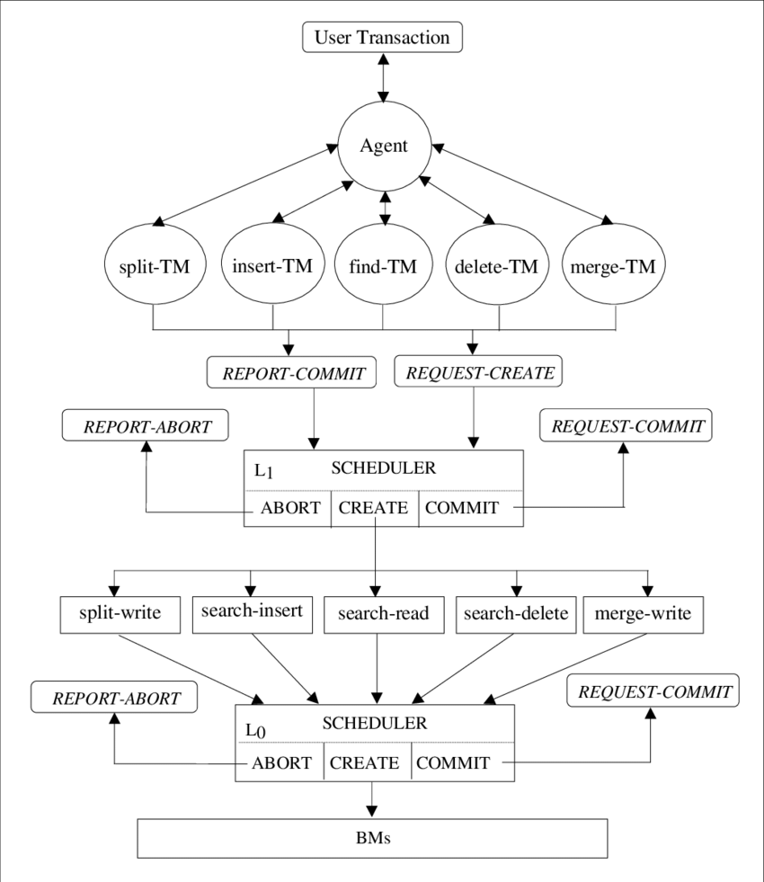
Multi-level Transaction Model

Slide 37
Long Lived Transaction
Avoid locks on non-local transaction
Aggregate smaller ACID transaction
Use coordinator to commit or abort the transaction
In contrast to rollback, compensation restores the original states, or equivalent business specific.
Notes:
Long-running transactions are computer database transactions that avoid locks on non-local resources, use compensation to handle failures, potentially aggregate smaller ACID transactions (also referred to as atomic transactions), and typically use a coordinator to complete or abort the transaction. In contrast to rollback in ACID transactions, compensation restores the original state, or an equivalent, and is business-specific. For example, the compensating action for making a hotel reservation is canceling that reservation, possibly with a penalty.
A number of protocols have been specified for long-running transactions using Web services within business processes. OASIS Business Transaction Processing and WS-CAF are examples. These protocols use a coordinator to mediate the successful completion or use of compensation in a long-running transaction.

Slide 38
Saga
A saga is a sequence of transactions that updates each service and publishes a message or event to trigger the next transaction step. If a step fails, the saga executes compensating transactions that counteract the preceding transactions.

Slide 39
Understanding saga
A LLT is a saga if it can be written as a sequence of transactions that can be interleaved with other transactions
What is the Objective of saga?
Make long transaction execution efficient.
Single window, less human interaction transaction design to improve customer satiesfiction
Notes:
Long lived transactions (LLTs) hold on to database resources for relatively long periods of time, slgmficantly delay amomg the termmatlon of shorter and more common transactions To alleviate these problems we propose the notion of a saga A LLT is a saga if it can be written as a sequence of transactions that can be interleaved with other transactions The database management system guarantees that either all the transactions m a saga are successfully completed or compensatmg transactions are run to amend a partial execution Both the concept of saga and its lmplementatlon are relatively simple, but they have the potential to improve performance slgmficantly

Slide 40
What are the challenges of LLT?
Resources are blocked a long time in LLT, thus other transaction get delay.
Higher abort Rate
Deadlock frequency grows with the forth power of the transaction size.
Notes:
In most cases, LLTs present serious performance problems Since they are transactions, the system must execute them as atomic actions, thus preserving the consistency of the database [DateSla,Ullm82a] To make a transaction atomic, the system usually locks the objects accessed by the transaction until It commits, and this typically occurs at the end of the transactlon As a consequence, other transactions wishing to access the LLT’s objects suffer a long locking delay If LLTs are long because they access many database obJects then other transactions are likely to suffer from an mcreased blockmg rate as well, 1 e they are more likely to conflict with an LLT than with a shorter transaction.
Furthermore, the transaction abort rate can also be increased by LLTs As discussed m [Gray8lb], the frequency of deadlock 1s very sensitive to the “size” of transactions, that IS, to how many oblects transactions access (In the analysis of the deadlock frequency grows with the fourth power of the transaction size ) Hence, since LLTs access many oblects, they may cause many deadlocks, and correspondingly, many abortions From the point of view of system crashes, LLTs have a higher probability of encountering a failure (because of their duration), and are thus more likely to encounter yet more delays and more likely to be aborted themselves

Slide 41
Saga Principal:
A transaction T is divided into Ti number of sub-transactions
For each Ti, a compensation transaction Ci is designed.
then the system can make the following guarantee:
Either the sequence Tl, T2, …Tn (which 1s the preferable one)
Or
the sequence
TI, T2 Tj, Cj C2, Cl
for some 0 <= J < n will be executed

Slide 42
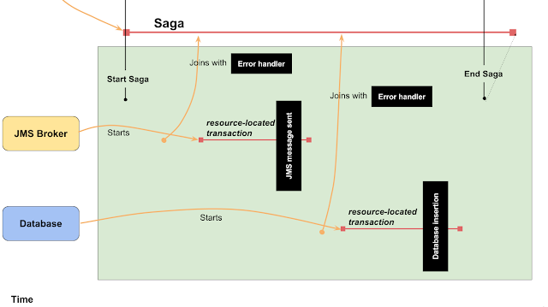
Notes:
Let’s try to elaborate a little bit
First saga manager starts Saga
The business logic sends a message to the JMS queue. This business operation is attached to Saga which brings obligation from to define a compensation handler (a chunk of code which is executed in case of Saga needs to be aborted). Sending of the message is wrapped into a short local transaction which ends when JMS message is acknowledged by the receiver.
The business logic inserts a row into the database table - again, the operation is attached to Saga, the SQL insert command is covered by short local transaction and a compensation handler has to be defined to undo the insertion in case of abortion of the Saga
If everything goes fine this is the end of the Saga and business logic can continue with another saga.

Slide 43
Thank you
Reference Book:
1. Distributed Database Principles and Systems, Stefano Ceri and G Palegatti, TMGH

